Slide 1

University Management System Website
The University Management System is a comprehensive platform that streamlines administrative tasks, empowers students, and fosters a vibrant campus community.

Slide 2
Team Members :
Ezz Eldeen Amer Ali
AlMoaid Hashem Hashem
Supervised by :
Hossam Salah Hassan
Eng. Shrouk Gamal El-Ossaily
Ahmed Ashraf Taher
Ahmed Mostafa Ahmed
Digital Egypt Pioneers Initiative - DEPI

Slide 3
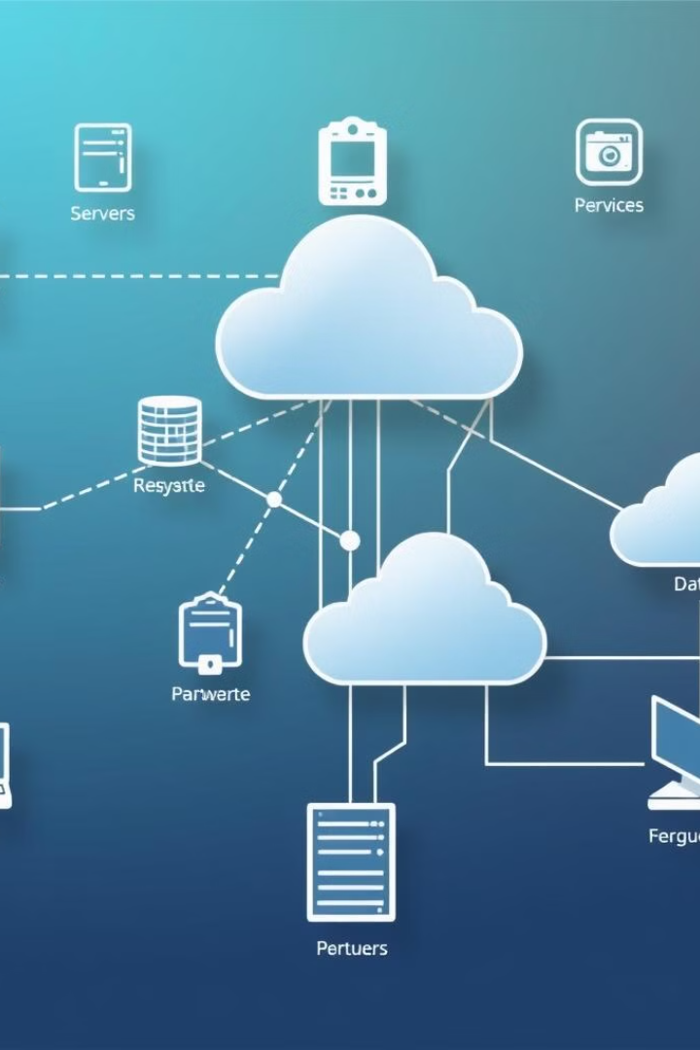
Overview of the system
An online platform for managing the learning process in universities, this website allows students to enroll in different courses, attend quizzes, and track their grades while allowing the professors to manage their own courses that they teach allowing them to add content, quizzes, and grades.

Slide 4
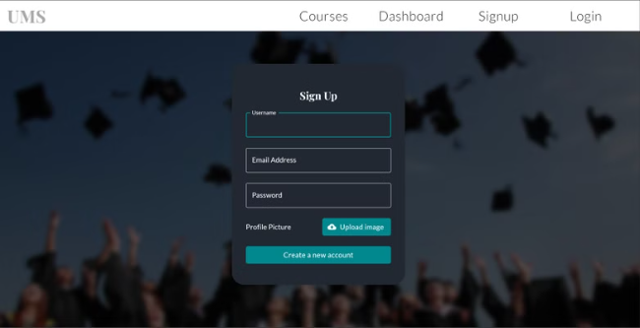
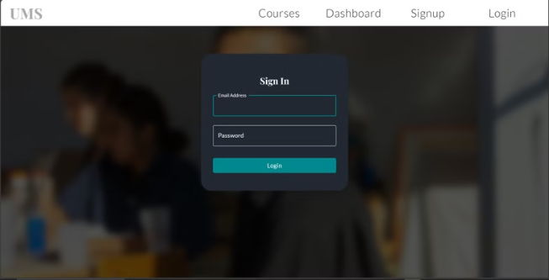
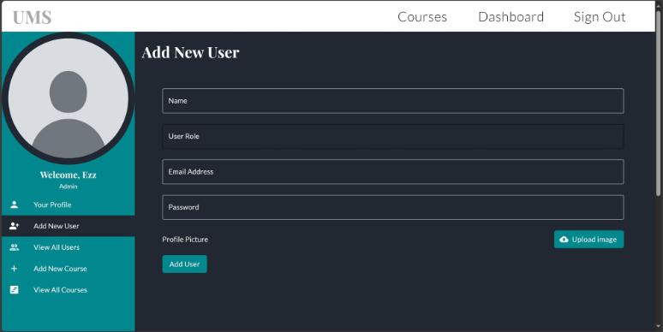
Main Features
User Authentication: Students can sign up and log in, admins can create professors and other admins.

Slide 5
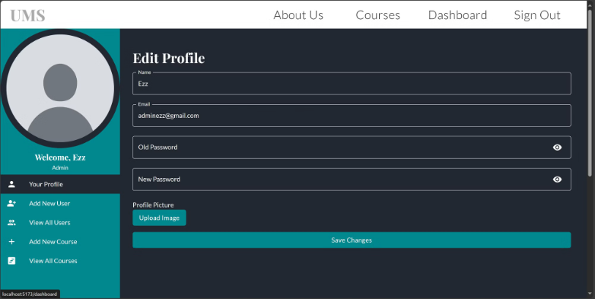
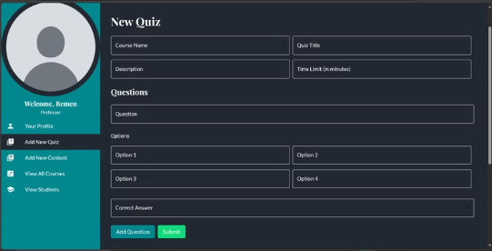
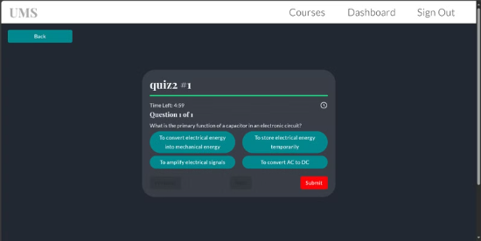
Main Features
User Authorization: Every type of user has their own Dashboards and authorities.
MCQ Quiz System: Professors can add new quizzes and students can take quizzes and get their marks

Slide 6
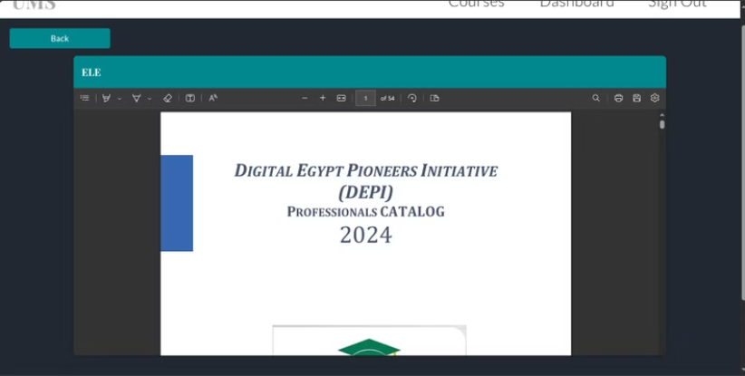
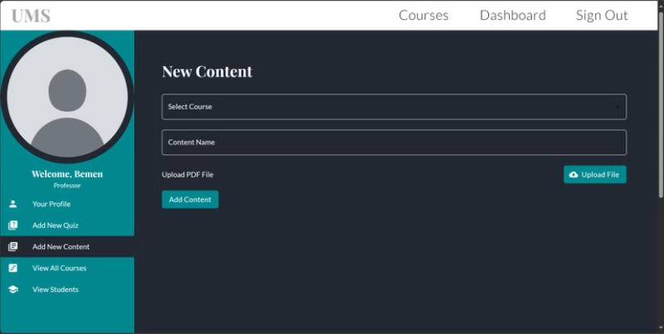
Main Features
Course content: Professors can add new material (PDFs) and students can view.
Modern and responsive Design

Slide 7
Student registration and enrollment
Online Application
Enrollment Management
Academic Advising
Intuitive interface guides students through the application process.
Tracks student status, course selection, and progress towards degree completion.
Provides personalized guidance to help students navigate their academic journey.

Slide 8

Course scheduling and management
1
Course Catalog
Comprehensive listing of all available courses, including descriptions, prerequisites, and schedules.
2
Class Scheduling
Intelligently assigns classrooms, professors, and time slots to optimize the academic calendar.
3
Student Enrollment
Allows students to easily select and enroll in their desired courses.

Slide 9

Grading and transcripts
Grade Entry
Streamlined interface for faculty to submit student grades .
Grade Calculations
Automatically computes grade point averages and academic standing.
Verification Services
Provides secure access to student records for authorized parties.

Slide 10

Conclusion and future enhancements
The University Management System Website is a powerful tool that streamlines administrative tasks, enhances the student experience, and drives continuous improvement. As technology and student needs evolve, the system will continue to expand its capabilities to meet the changing demands of modern higher education.

